Slide 1



Investigating the Origin of Fine-Grained Rims in Mighei-Like Carbonaceous Chondrites
Xeynab Mouti, Jemma Davidson, Devin Schrader
ASU Center for Meteorite Studies
Arizona NASA Space Grant Consortium Symposium
17th April 2021

Slide 2
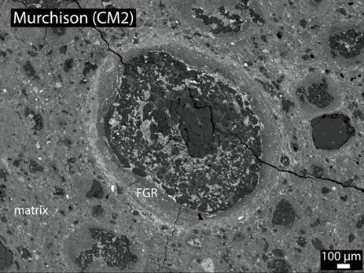
Introduction and Problem
Mighei-like carbonaceous (CM) chondrites are the most abundant carbonaceous chondrite group
Closest match to asteroid sample return missions
OSIRIS-REx and Hayabusa2 (e.g., Hamilton et al 2019)
Fine-grained rims (FGRs) often encircle chondrules (e.g., Metzler et al., 1992)
Their formation is disputed - two major hypotheses
1. Nebular Origin (e.g., Hanna & Ketchum, 2018)
2. Parent Body Origin (e.g., Sears et al., 1993)
Chondrule in Murchison displaying FGR

Slide 3
Objectives
To determine whether fine-grained rims formed in the nebula or on the parent body
Sample | Peak Metamorphic Temperature
Allan Hills (ALH) 83100,189 | <220°C
Meteorite Hills (MET) 01072,23 | -,<220°C
Elephant Moraine (EET) 96029,27 | - ,-
Murchison USNM 5376-1 | <300°C, <220-240°C
Yamato (Y)-793321,60-4 | <500°C
Pecora Escarpment (PCA) 91008,21 | <750°C
Analyzed six CMs that had experienced a range of parent body processes including heating and aqueous alteration

Slide 4
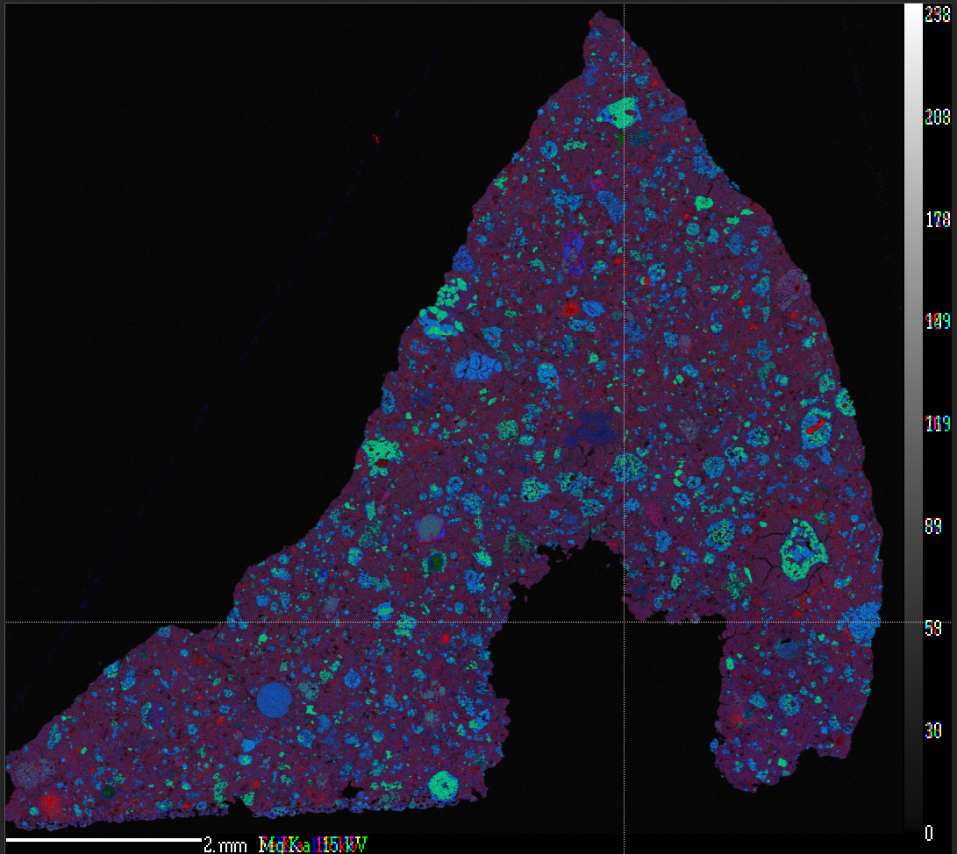
Methods & Analysis
Chondrules identified and numbered (approx. 300 per meteorite)
Major and minor axes drawn and measured
Angles of the major axes were used to determine the presence of foliation
The area of the FGRs and their corresponding interior chondrule was measured
From 2D EPMA (electron probe microanalyzer) images
FeMgSi
FeMgSi
2mm
FeMgSi map of PCA 91008

Slide 5
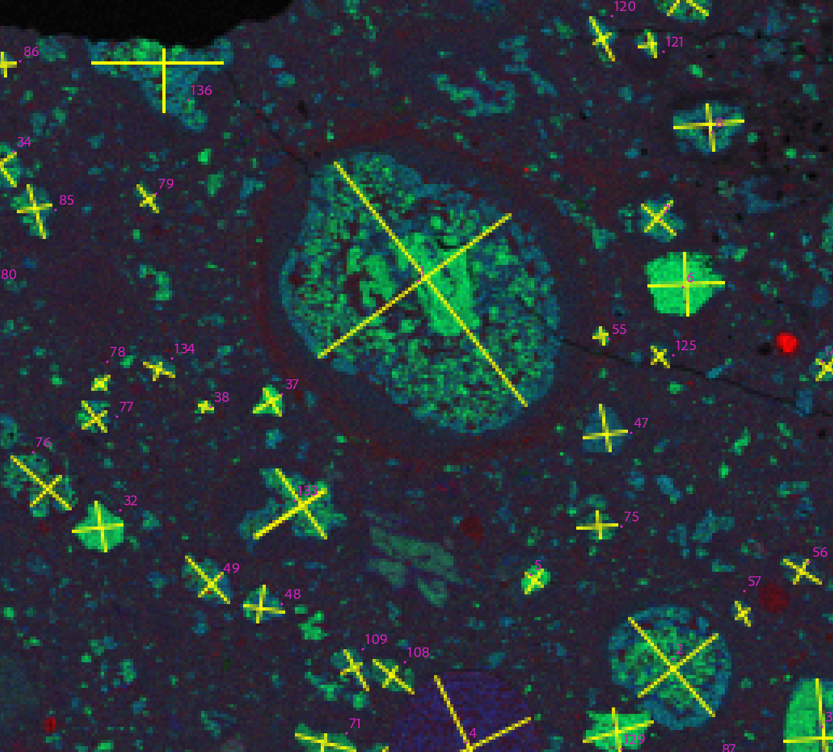
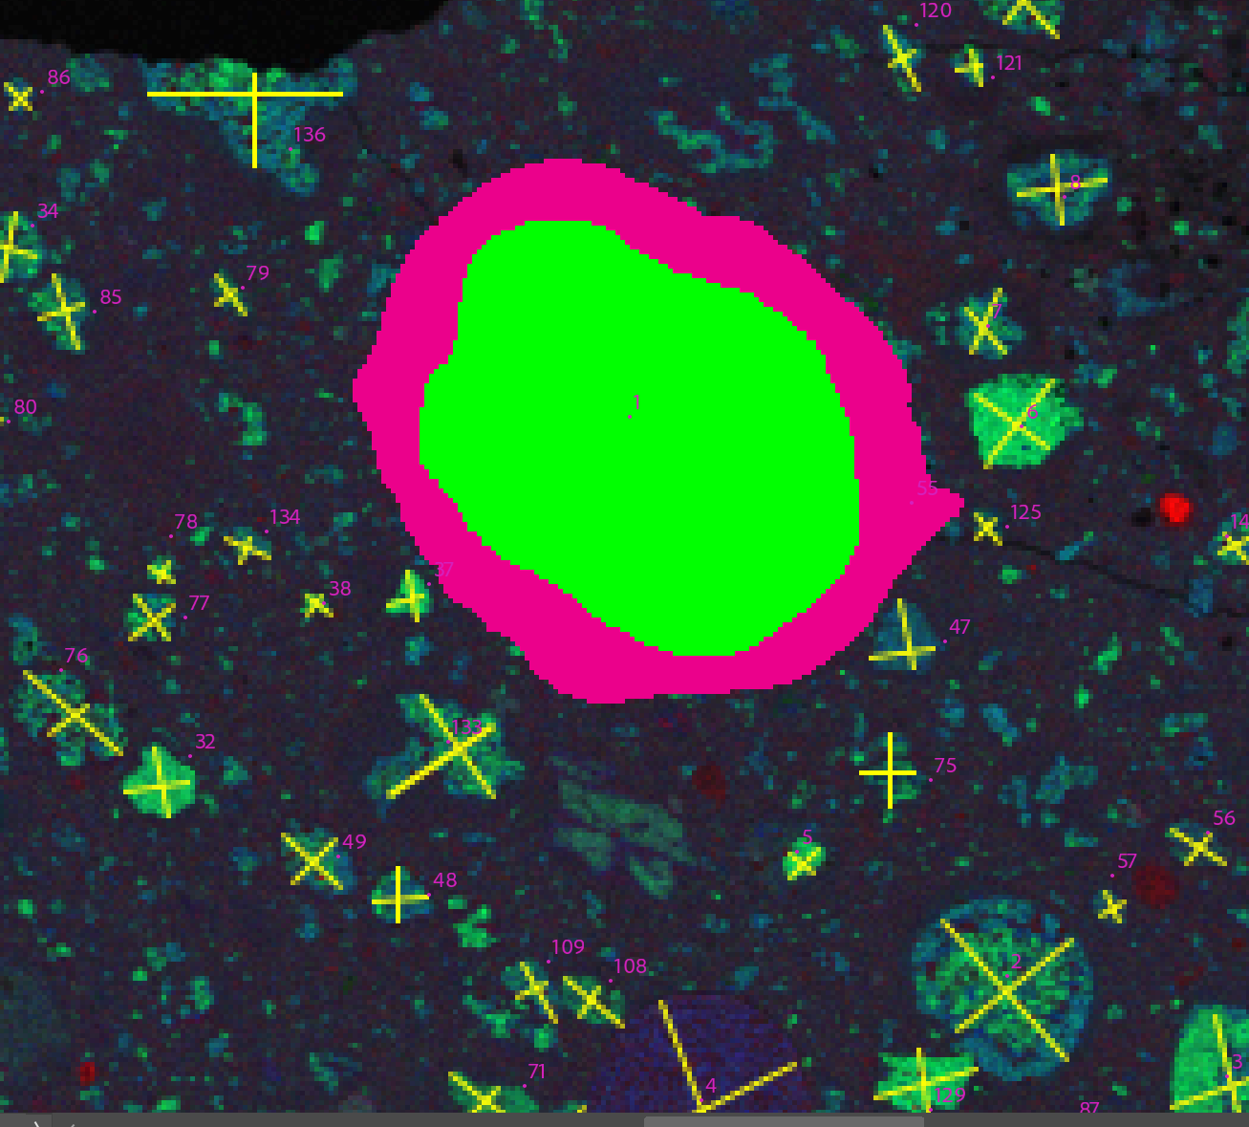

Methods & Analysis
100μm
FeMgSi
BSE image of chondrules in Murchison
Murchison chondrules numbered with axes
FGR around chondrule 1 in Murchison

Slide 6
Results
Sample | Avg. Total Ch. Axes Dia. (mm) | Avg. FGR area (mm²) | # of FGRs
Allan Hills (ALH) 83100,189 | 0.201 | 0.0569 | 5
Meteorite Hills (MET) 01072,23 | 0.135 | 0.0333 | 166
Elephant Moraine (EET) 96029,27 | 0.156 | 0.0772 | 90
Murchison USNM 5376-1 | 0.189 | 0.0973 | 63
Yamato (Y)-793321,60-4 | 0.194 | 0.0522 | 86
Pecora Escarpment (PCA) 91008,21 | 0.136 | 0.0337 | 67
Table 1. Summary of Data Collected

Slide 7
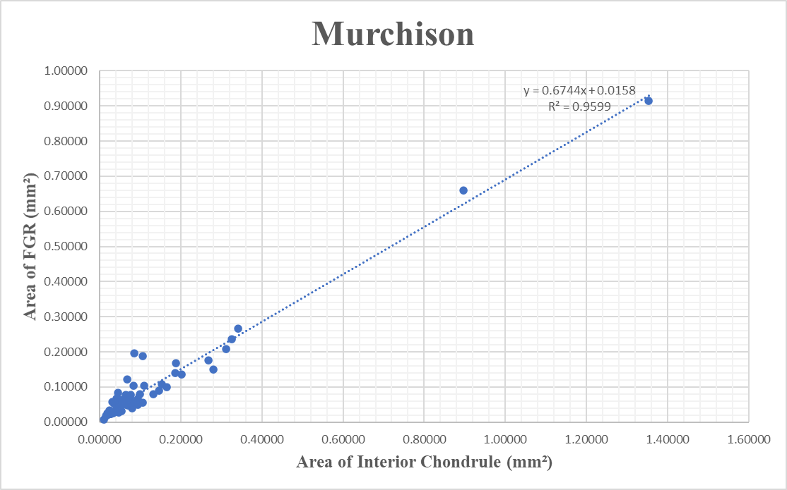
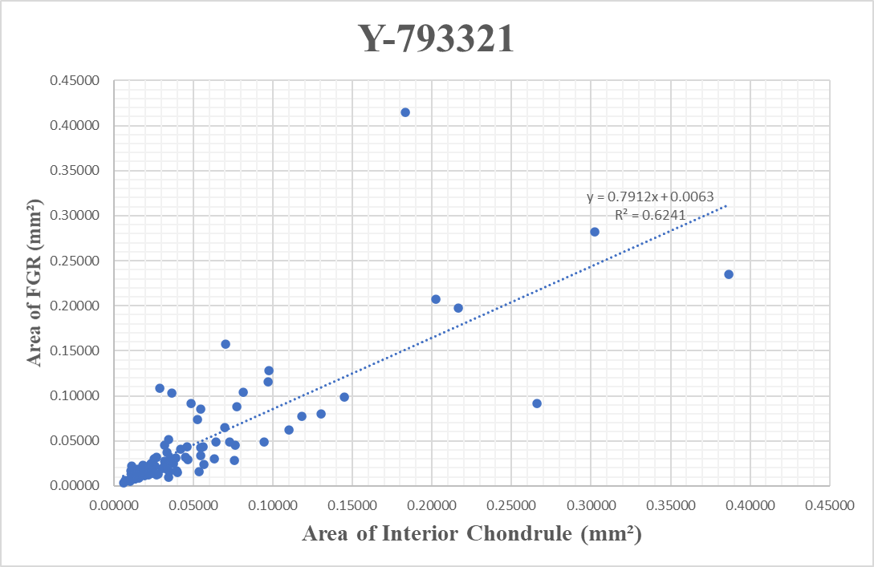
Results

Slide 8
Discussion
Average chondrule diameter smaller than previous studies, but our study measured more chondrules and used pixel counting on BSE
No correlation between size or abundance of FGRs and degree of heating
More aqueous alteration = higher average FGR size and less FGRs visible → Likely that chondrules with smaller FGRs altered and “erased” by aqueous alteration
Positive correlation between the area of the FGR and the area of the corresponding interior chondrule

Slide 9
Conclusions
We propose a smaller average diameter for chondrules in CM carbonaceous chondrites than previous studies. We suggest that chondrule size not be solely used to differentiate between CMs and COs
Our data supports a nebular origin for FGRs in CM chondrites, with parent body processes subsequently altering them significantly
Implications for asteroid sample return missions (i.e., OSIRIS-REx and Hayabusa2)

Slide 10
Acknowledgements
Mouti thanks the ASU/NASA Space Grant Program, the Barrett College Fellows Program, and the ASU Center for Meteorite Studies for supporting this research. We thank Dr. Emma Bullock for assisting in the collection of the elemental maps. We also thank the Smithsonian Institution, the National Institute for Polar Research (Japan), and the ANSMET program for the samples used in this work.

Slide 11
Thank you!

